Slide 1
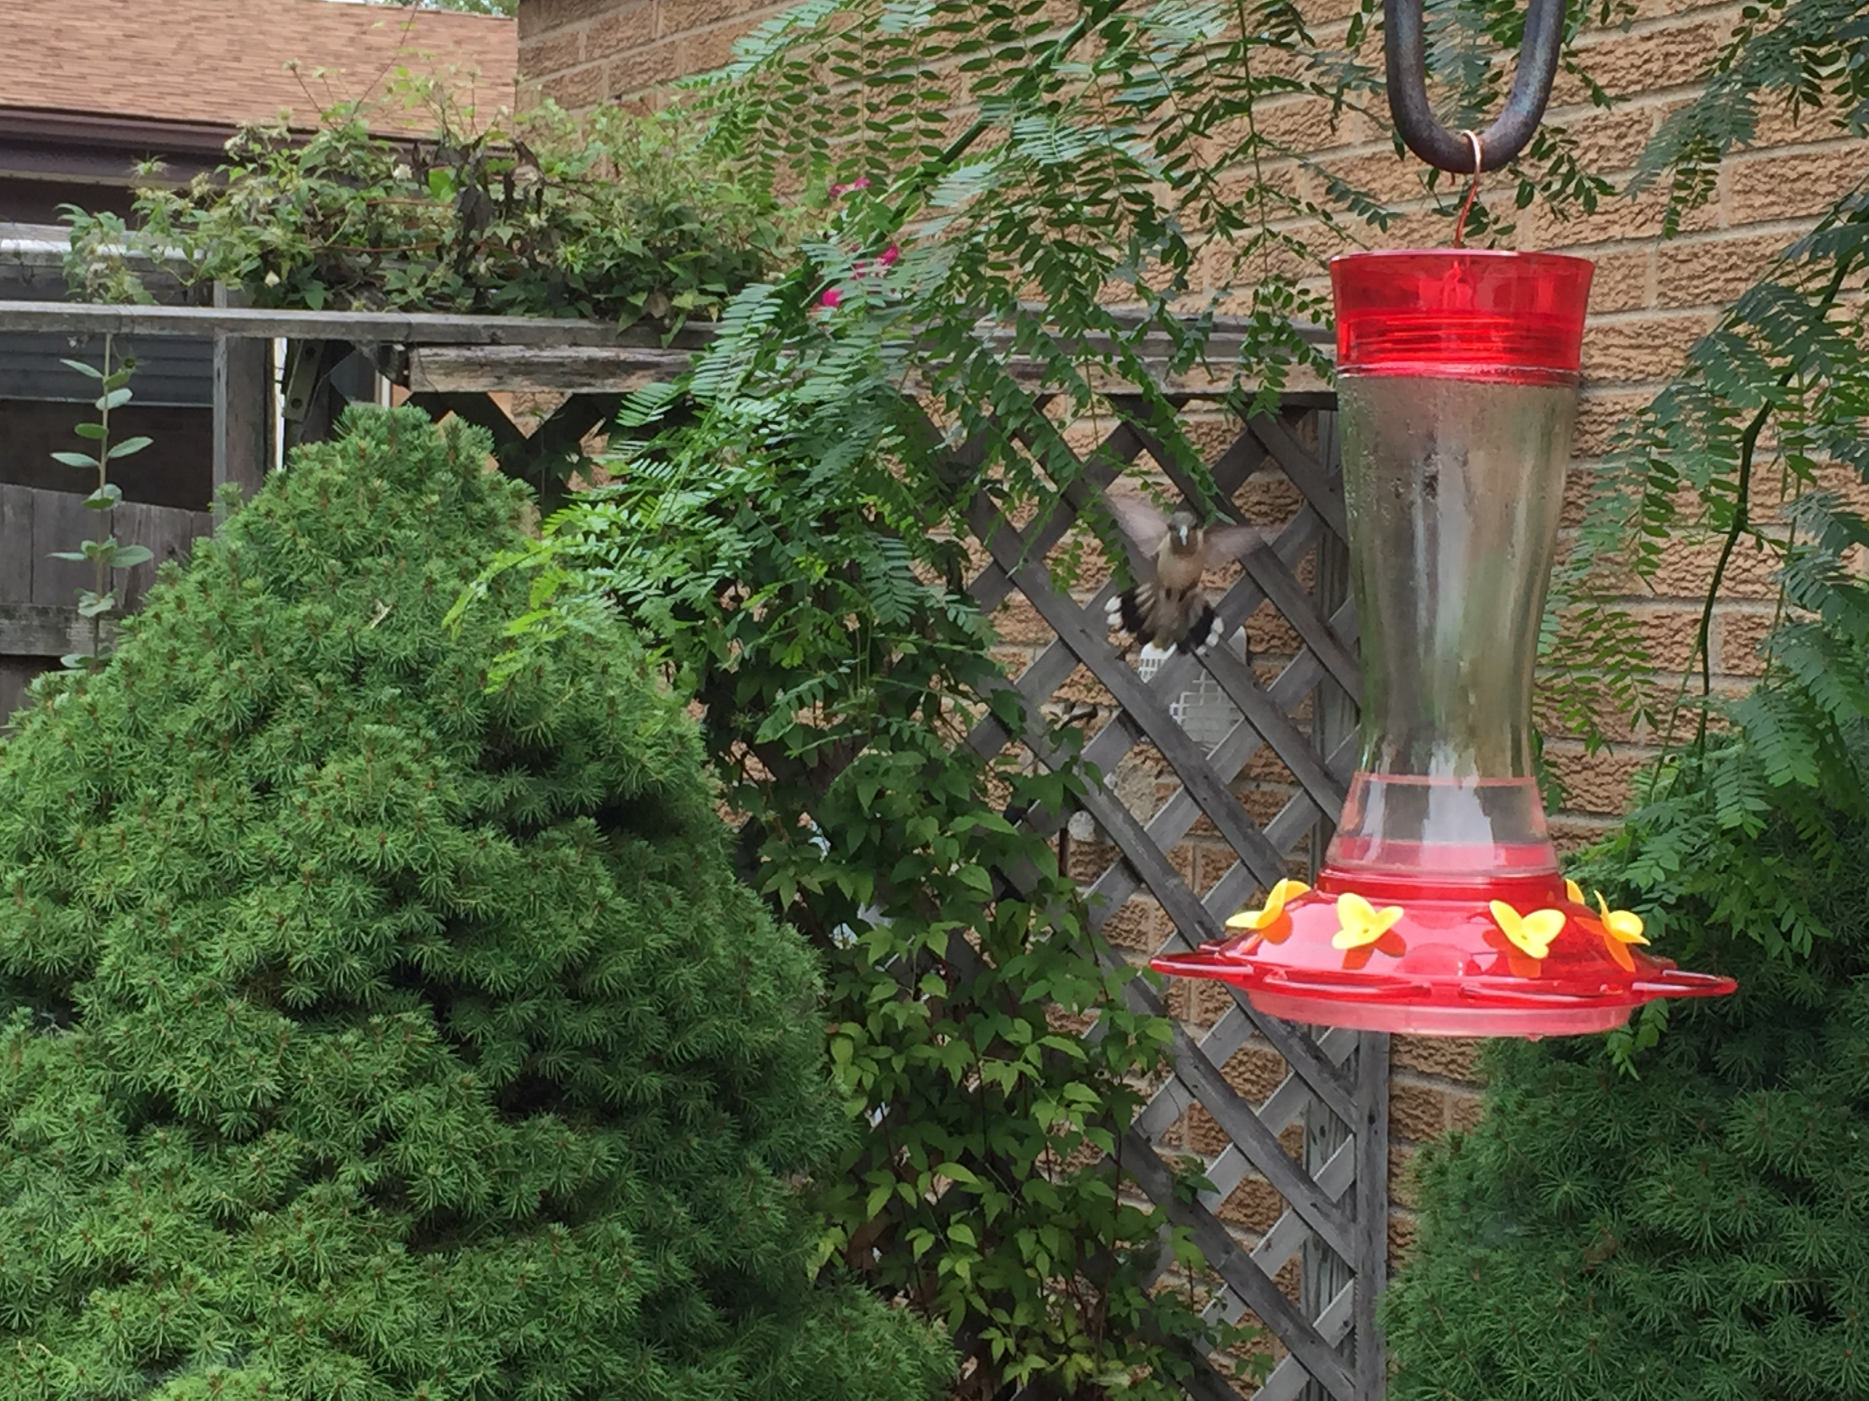

Attracting
Hummingbirds
Ruby-throated species is common
Adult weighs less than 2 ounces
Feeds daily on nectar

Slide 2
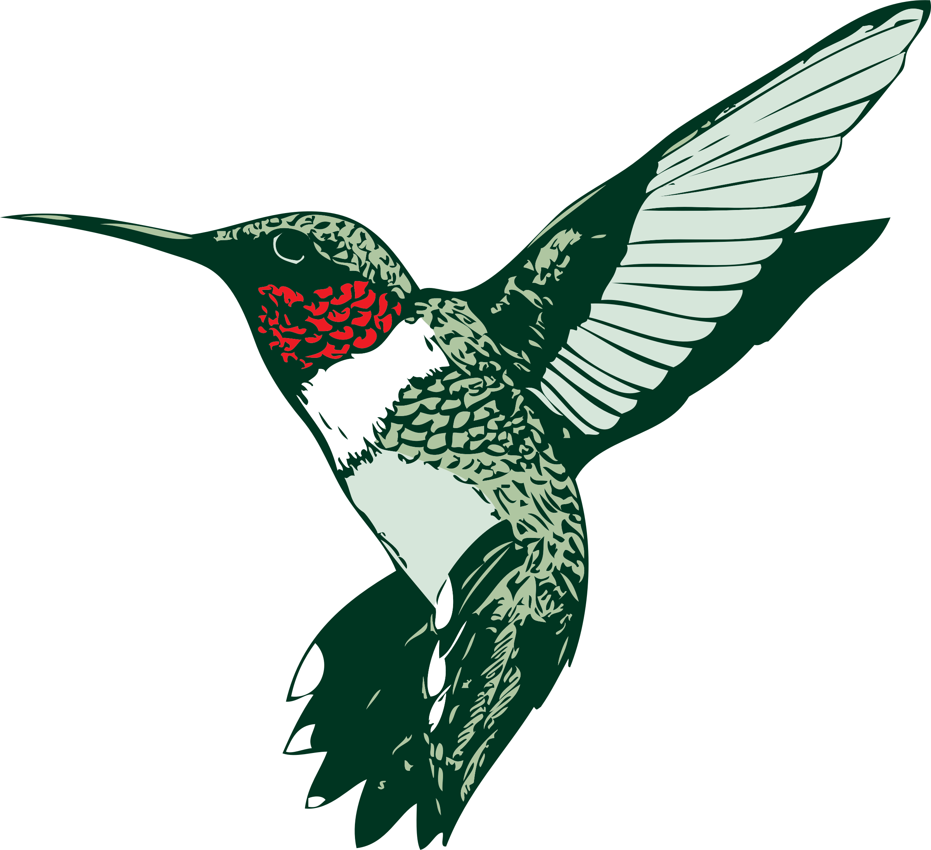
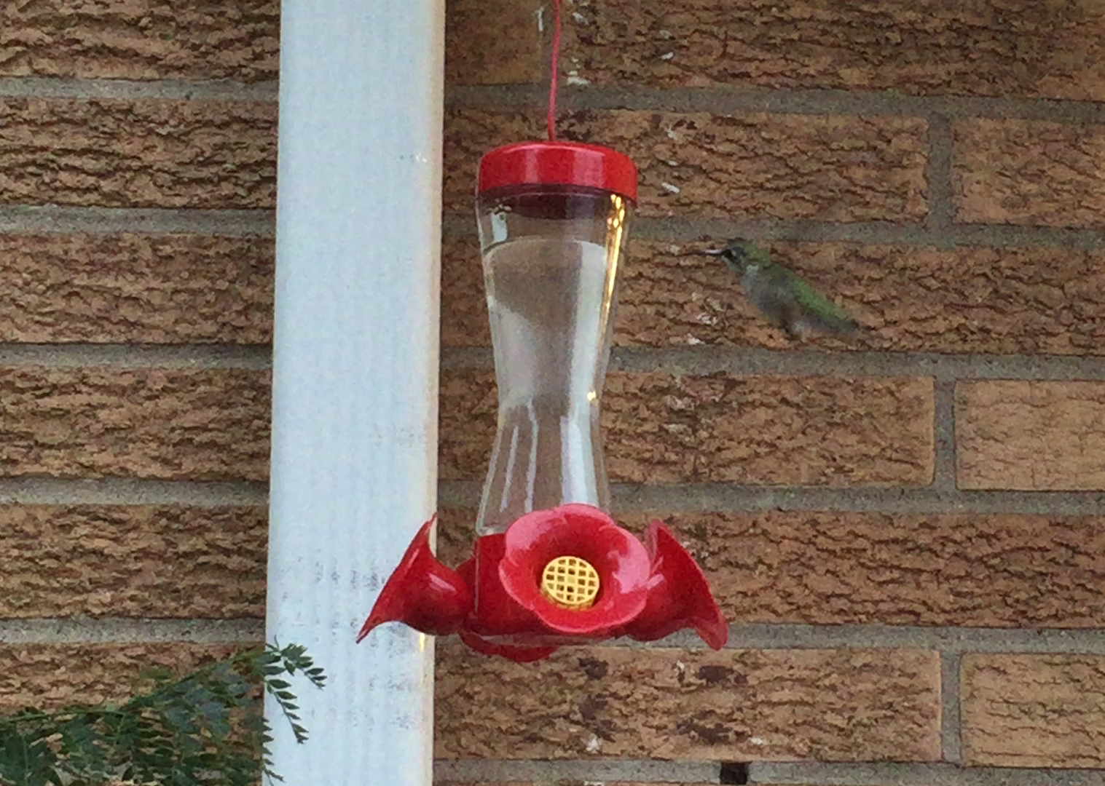
Selecting and Maintaining Feeders
Use glass container
Fill with clear nectar
Choose red accents
Clean and refill weekly

Slide 3
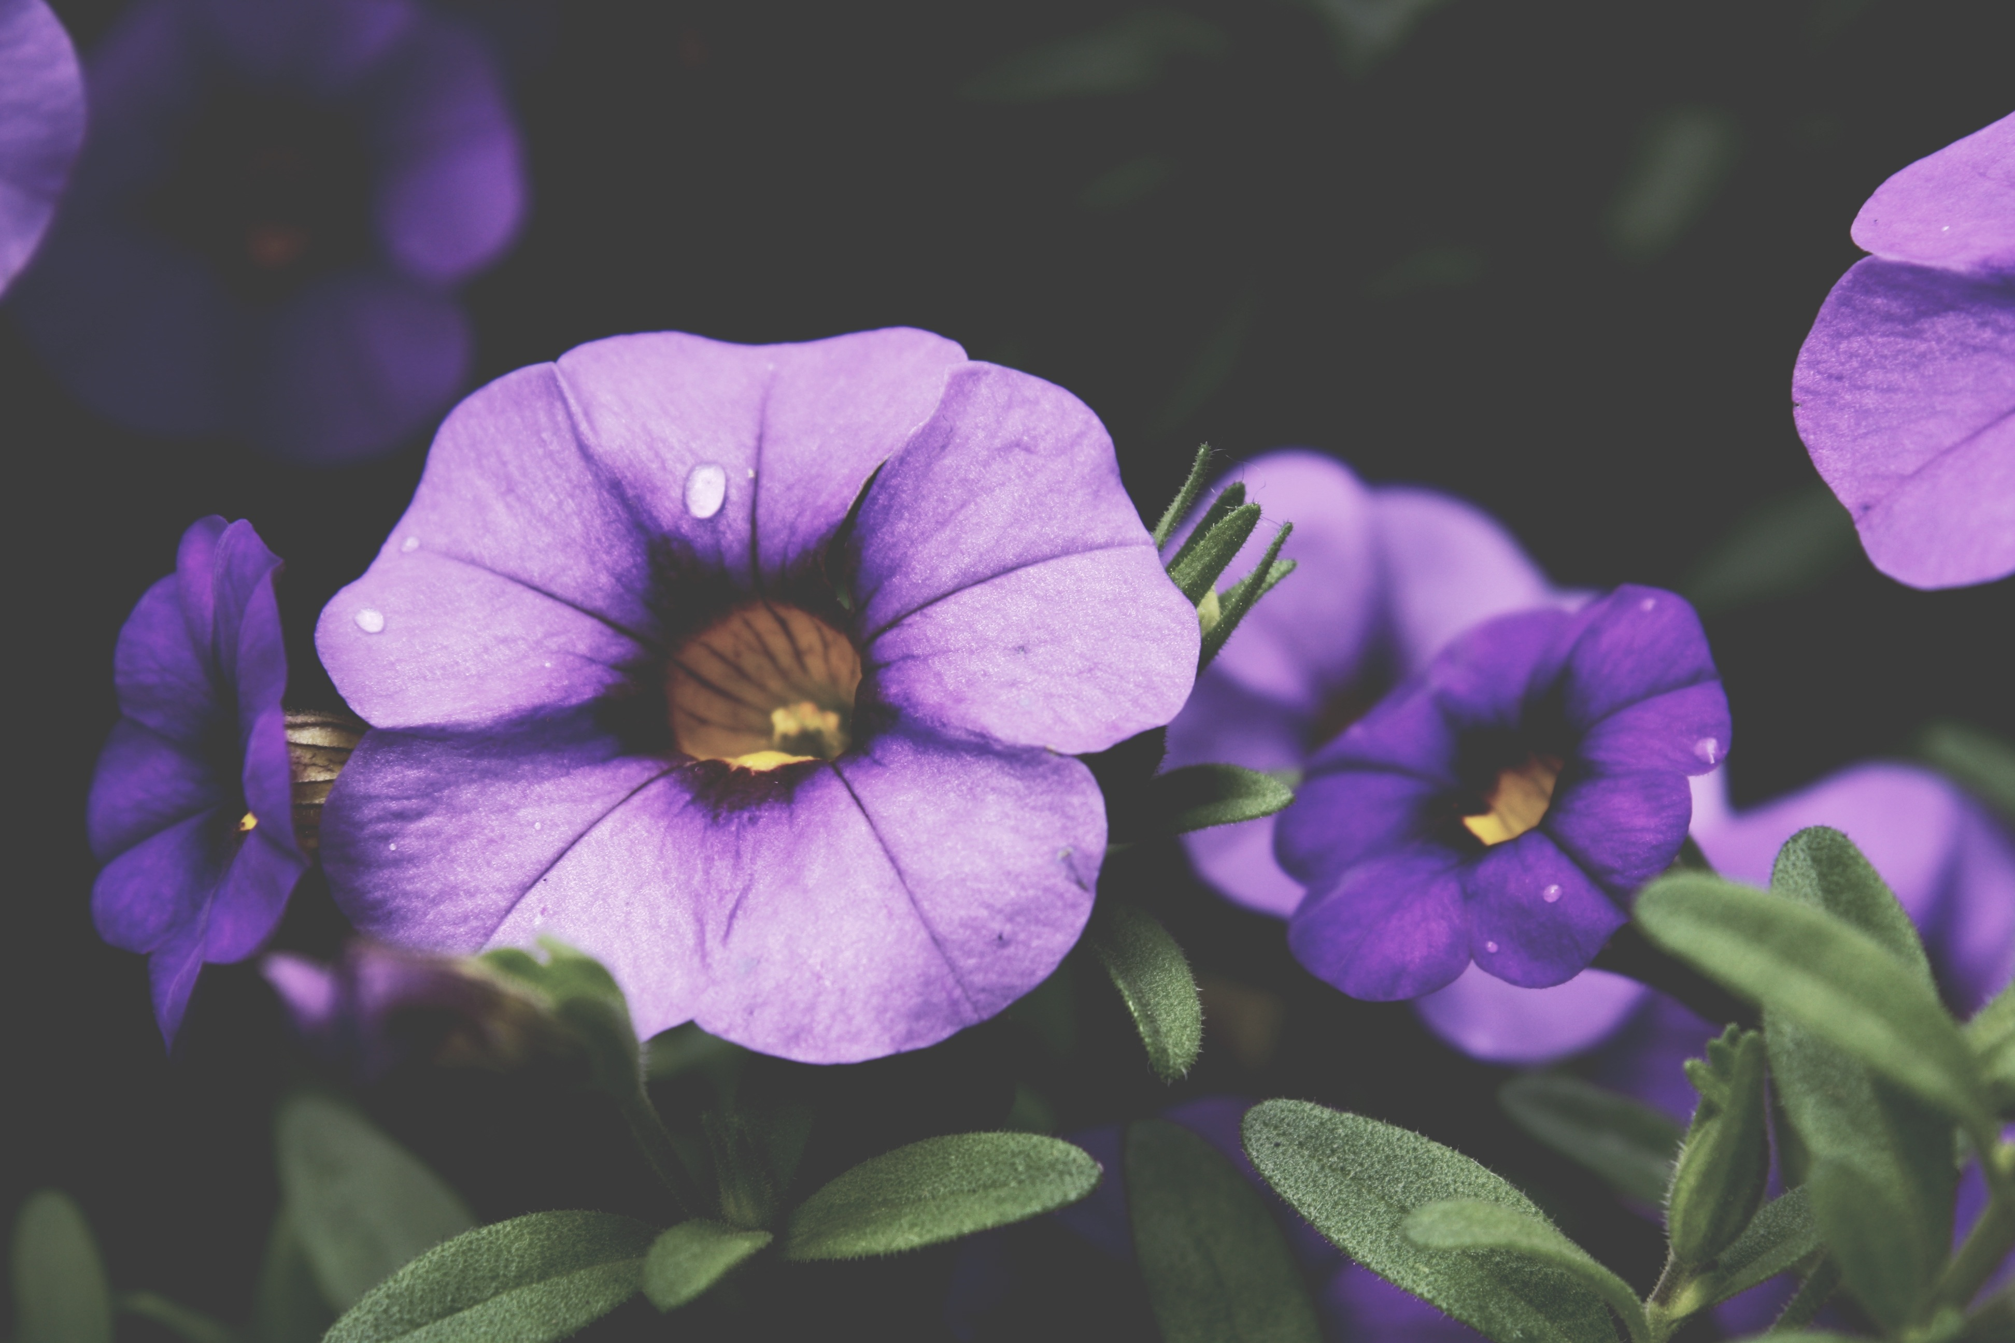
Best Flowers for Hummer Garden
Brightly-colored tubular shape
Perennials
  Daylily
  Columbine
Annuals
  Petunia
  Impatiens

